Slide 1


Python (Part-2)
10.Aug.2023

Slide 2
What is pytest?
pytest is a popular testing framework for Python that makes it easy to write simple and scalable test cases.
pytest emphasizes simplicity, ease of use, and powerful features for testing code.
pytest automatically discovers and runs test functions and methods based on naming conventions or specific markers, making it easy to organize and manage test cases.
pytest offers a powerful fixture system (way to set up and tear down resources needed for tests)
You can write parametrized tests to run the same test logic with different input values.

Slide 3

How to configure pytest?
To install pytest, you can use pip:
pip install pytest
e.g. code
def test_addition():
result = 2 + 3
assert result == 5, "Addition test failed"
Run the code
py.test -v -s test_demo2.py
OUTPUT:
test_pytest_sample.py::test_addition PASSED

Slide 4

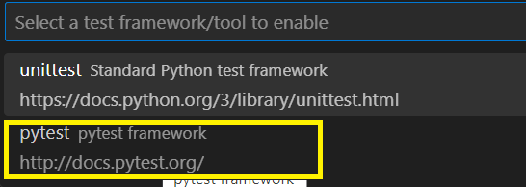
How to configure pytest?
Your test file should always start with "test_xxxxx"
pytest method names should start with test
Any code should be wrapped in method only & method name should have sense
To run all test files from a package, use the fommand
py.test -v -s
v – verbose (more details about test case execution
s– console output

Slide 5
How to configure pytest?
To run a specific file
py.test -v -s test_demo2.py
To run a specific test case
py.test -v -s -k 'credit_card'
This command will run all test cases that contains 'credit_card'. e.g:
def test_credit_card():
a = 4
b = 6
assert a + b == 6, "Addition does not match"

Slide 6
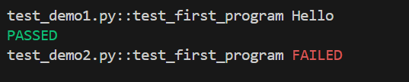
Tagging or grouping test cases
Annotate the test with @pytest.mark.<Tag-name>
@pytest.mark.smoke
def test_first_program():
print("Hello")
Run the test cases marked as "smoke"
py.test -v -s -m 'smoke'
To avoid showing warning messages for custom markers, add following code into the pytest.ini file
[pytest]
markers =
smoke: smoke test cases

Slide 7
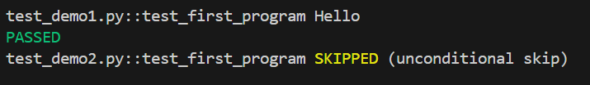
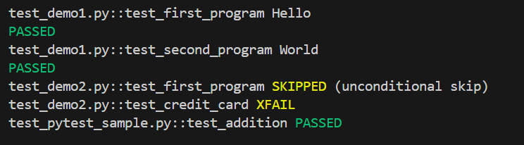
Tagging or grouping test cases
Skip a test case using mark @pytest.mark.skip
To avoid showing test result in the reporting, use @pytest.mark.xfail

Slide 8
What are fixtures?
Setup & teardown methods - @pytest.fixture() and yield
import pytest
@pytest.fixture()
def setup():
print("I will be executing first")
yield
print("I will be executing last")
def test_fixtureDemo(setup):
print("I will execute steps in fixtureDemo method")
By defining the fixture inside conftest.py files, it can be re-used across the test files.

Slide 9
How to use fixtures?
To use fixture setup common across multiple test cases, define the test cases inside a class
Tag @pytest.mark.usefixtures("setup") ] at class level
If you want to run the fixture only once before any test case in the class & once after all test case are completed, specific the scope as class in the configuration file
@pytest.fixture(scope="class")

Slide 10
Parameterization using fixtures
To use fixture setup common across multiple test cases, define the test cases inside a class
Define the texture name at class level
@pytest.mark.usefixtures("dataLoad")
Use the fixture name inside the method if you need to pass values into the test case
def test_edit_profile(self, dataLoad):
For passing parameters, define multiple parameters in the configuration
@pytest.fixture(params=[("chrome"), ("IE"), ("Edge")])
def crossBrowser(request):
return request.param

Slide 11
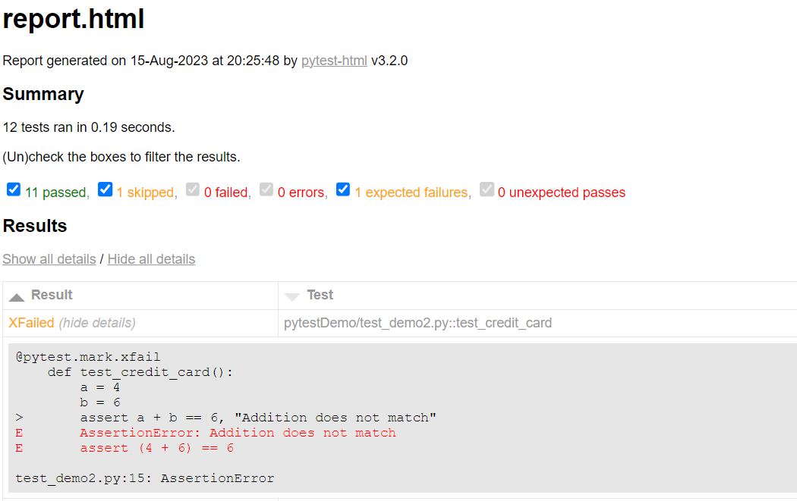
HTML report generation for test cases
Install pytest-html
While running the test cases, pass the following arguments
py.test --html=report.html

Slide 12
Logging in test execution
Your log should explain the steps executed
In case of failure, this log file can be analyzed for more details.
Log should have a timestamp, type (debug, info, warn, error etc)
Import logging package - import logging
Initialize logging - logger = logging.getLogger(__name__)
Specify file handler - fileHandler = logging.FileHandler('logfile.log')
Specify formatter & link to file handler-
formatter = logging.Formatter("%(asctime)s : %(levelname)s : %(name)s : %(message)s")
fileHandler.setFormatter(formatter)

Slide 13
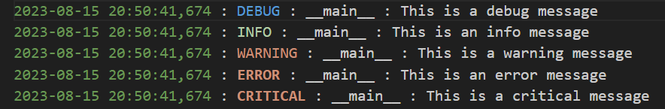
Logging in test execution
Add file handler to the logger - log.addHandler(fileHandler)
Set logging level log.setLevel(logging.INFO)
log.debug("This is a debug message")
log.info("This is an info message")
log.warning("This is a warning message")
log.error("This is an error message")
log.critical("This is a critical message")

Slide 14
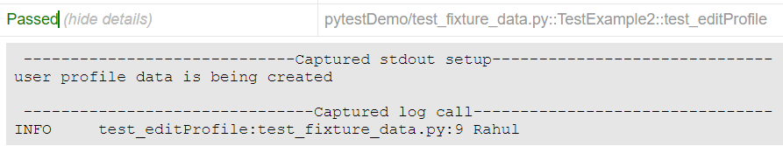
Logging in test execution
Define all configurations into a base class & inherit these features into your test class
Configure the logger to correctly reflect the test case name
logger_name = inspect.stack()[1][3]
log = logging.getLogger(logger_name)
After configuration, use following command to include logger information into the test case execution report
py.test --html=report.html

Slide 15
References
What is selenium: http://surl.li/kcxzt
Selenium with Python: http://surl.li/kcyab
Python tutorials: http://surl.li/kcyak
Selenium with Python full tutorial: https://youtu.be/2DD-ynCIZ4w
Selenium with Python & PyTest: https://youtu.be/57pjD89IFXA

Slide 16


